Slide 1
CAR PRICE PREDICTION PROJECT
Submitted by :
Rupali Bisen

Slide 2
MOTIVATION FOR THE PROBLEM UNDERTAKEN
In this project,we have to make carprice valuation model using new machine learning models from new data. Because with the change in market due to covid 19 impact, our client is facing problems with their previous car price valuation machine learning models.
It is a very large market and there are various companies working in the domain.
Data science comes as a very important tool to solve problems in the domain to help the companies increase their overall revenue, profits, improving their marketing strategies and focusing on changing trends in car sales and purchases.

Slide 3
ANALYTICAL PROBLEM
FRAMING

Slide 4
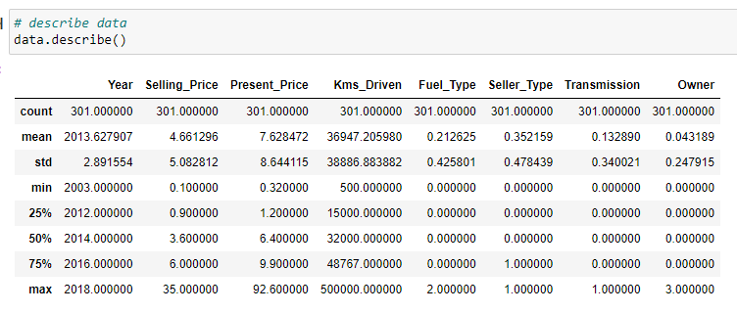
MATHEMATICAL/ ANALYTICAL MODELING OF THE PROBLEM
In this project we have performed various mathematical and statistical analysis such as we checked description or statistical summary of the data using describe, checked correlation using corr and also visualized it using heatmap. Then we have used Z-Score to plot outliers and remove them.

Slide 5
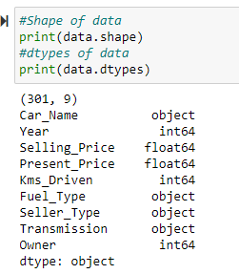
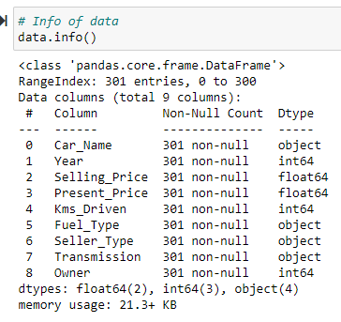
DATA SOURCES AND THEIR FORMATS

Slide 6
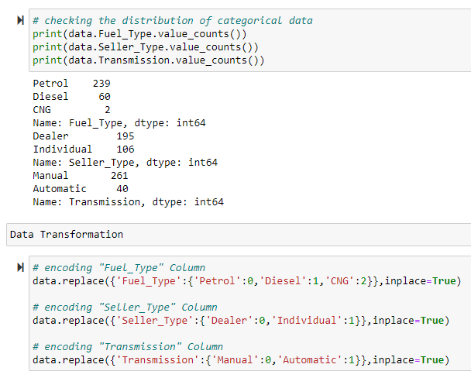
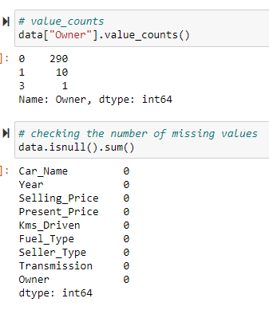
DATA PREPROCESSING

Slide 7
DATA PREPROCESSING
Feature Engineering has been used for cleaning of the data.
Some unused columns have been deleted and even some columns have been bifurcated which was used in the prediction.
We first done data cleaning. We first looked percentage of values missing in columns then we imputed missing values.

Slide 8
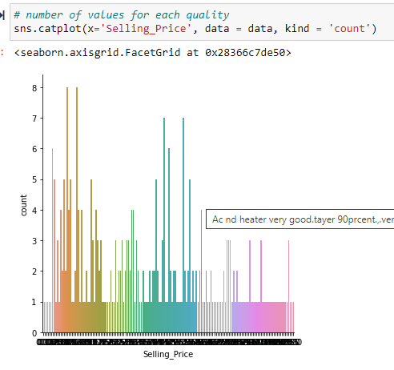

Slide 9
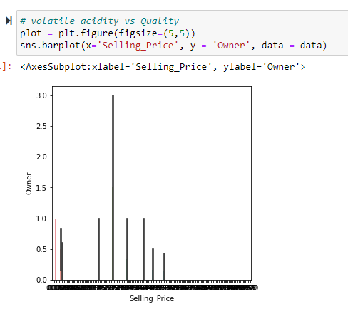

Slide 10
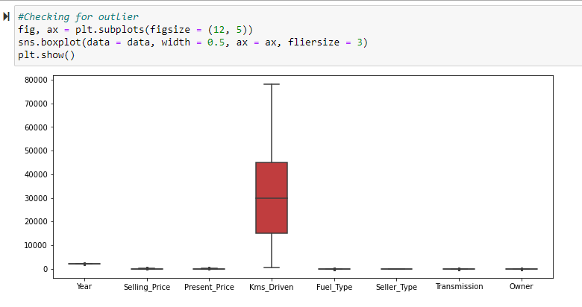
Checking for outliers

Slide 11
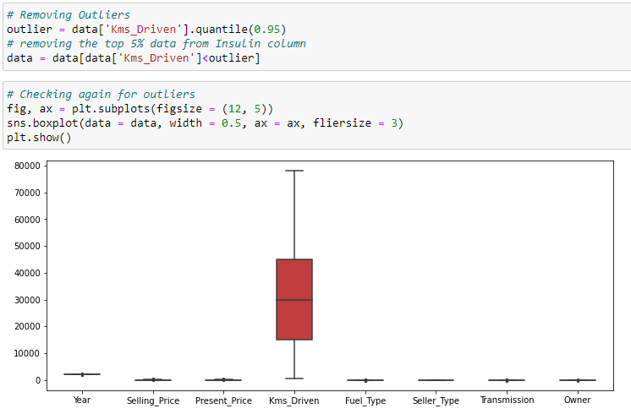
Removing for outliers

Slide 12
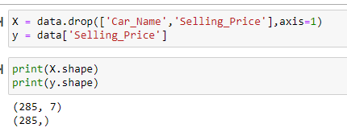
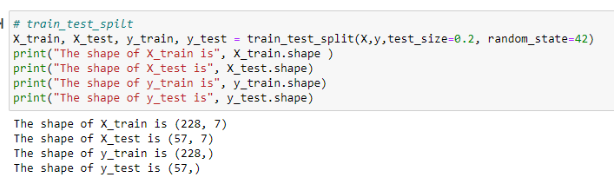
Model Preparation

Slide 13
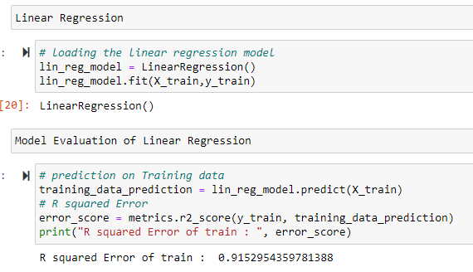
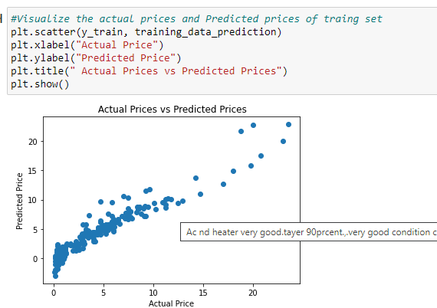
MODEL TRAINNING

Slide 14
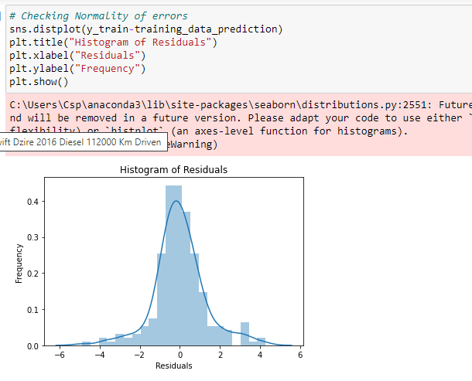
Linear regressor

Slide 15
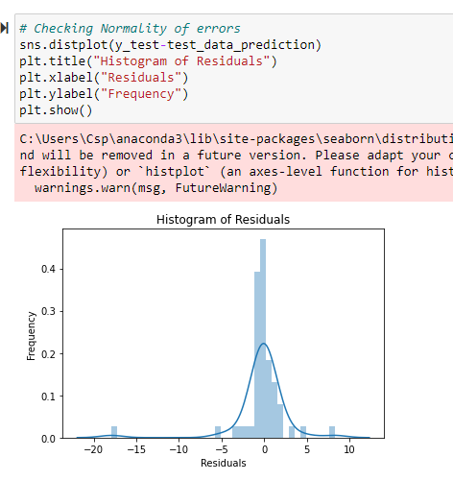
Linear regressor

Slide 16
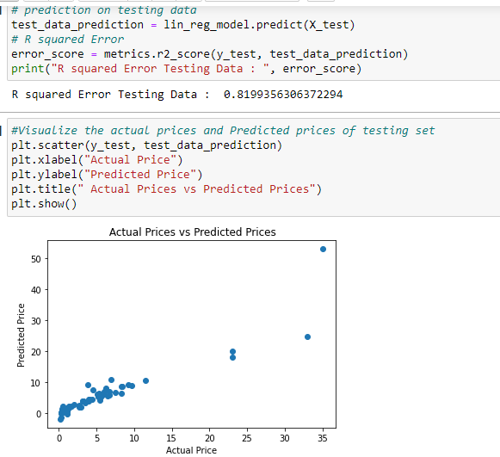
Linear regressor

Slide 17
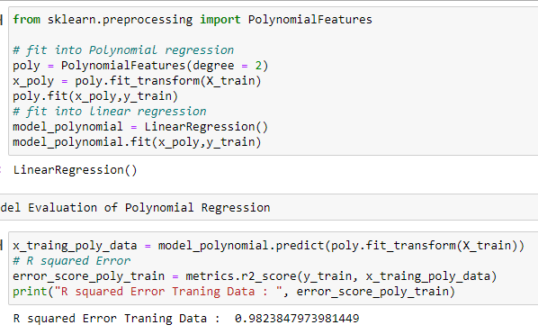
Polynomial Regression

Slide 18
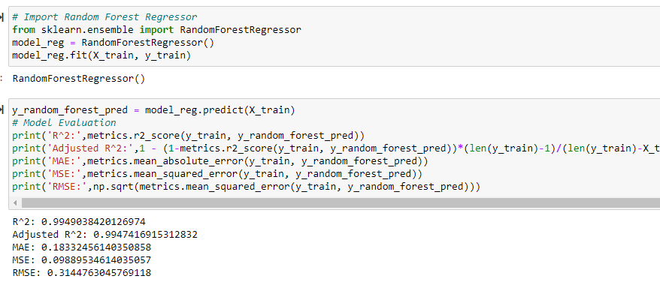
Random Forest Regressor

Slide 19
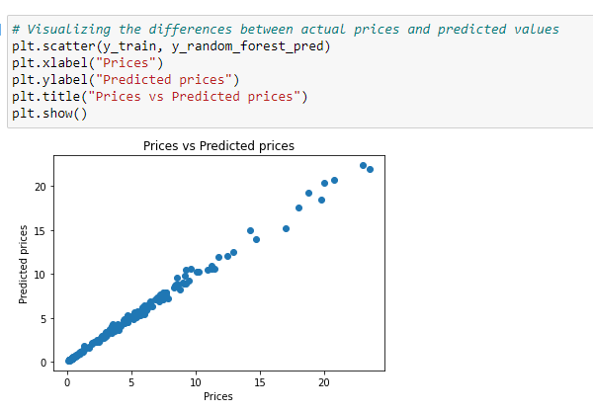
Random Forest Regressor

Slide 20
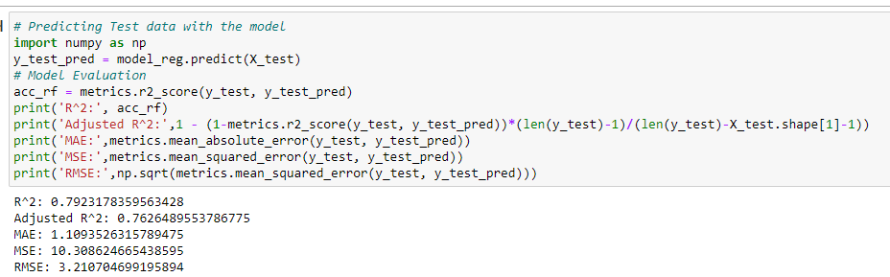
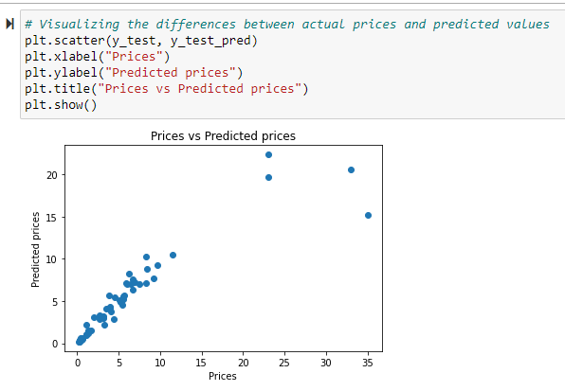
Random Forest Regressor

Slide 21
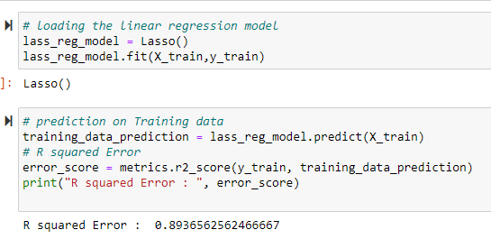
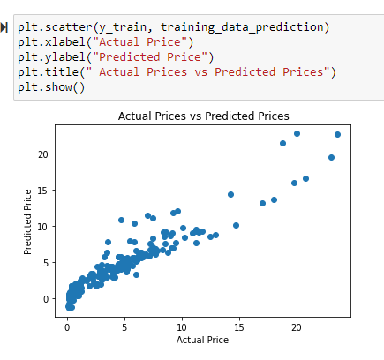
Lasso Regressor

Slide 22
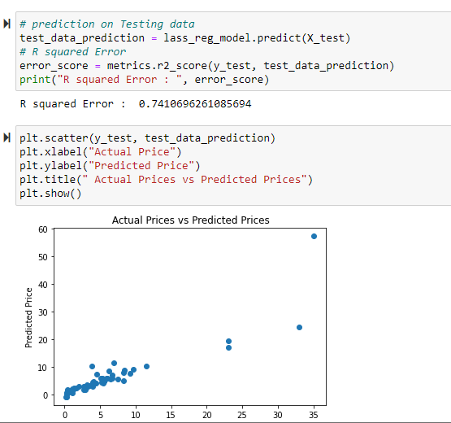
Lasso Regressor

Slide 23
INTERPRETATION OF THE RESULTS
We will develop relevant programming abilities. We will demonstrate proficiency with statistical analysis of data. We will develop the ability to build and assess data-based models. We will execute statistical analysis with professional statistical software. The best algorithm for this project according to my work is LassoRegressor because the accuracy that I have achieved is quite satisfactory than the other model.

